Slide 1

ASTRONOMY IN THE NEWS
#01 – RETURNING A SAMPLE FROM TITAN

Slide 2
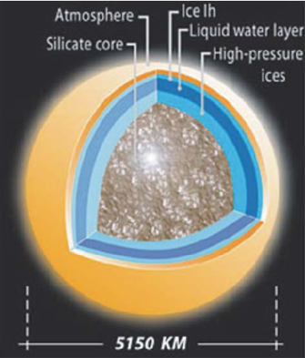
Titan
Credit:NASA/JPL-Caltech/Space Science Institute
Credit:Tobie et al. (2005)
Credit: NASA / JPL-Caltech / USGS

Slide 3
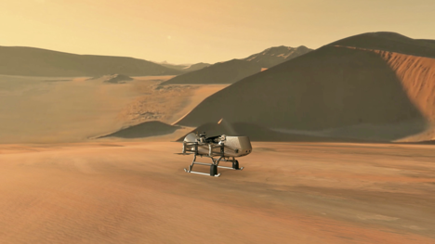
Future Missions to Titan
Dragonfly
Credit: NASA / JHU-APL

Slide 4
Returning a sample from Titan
A feasibility study for a project (probably 50 years from now) is currently underway. The project aims to fly a robot to Titan, go to the surface, obtain samples and then return these samples to Earth for further analysis.
Two questions emerge:
Where would the fuel come from? You cannot carry too much equipment, so it cannot be taken there
How do you produce oxygen to burn this fuel?

