Slide 1

ASTRONOMY IN THE NEWS
#02 – DARK MATTER MAP

Slide 2
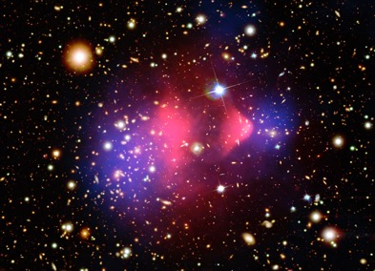
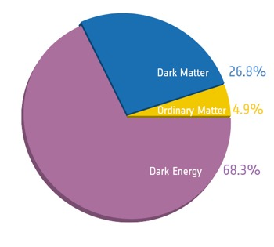
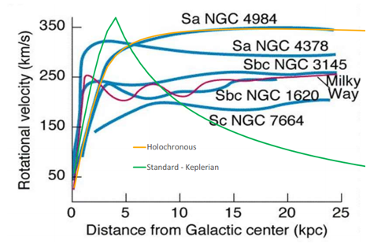
Dark Matter
Credit: NASA/CXC, NASA/STScI
Credit: ESA/Planck
Credit: Robin Booth

Slide 3
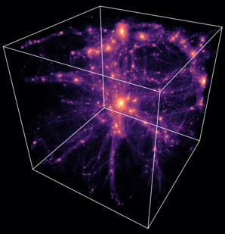
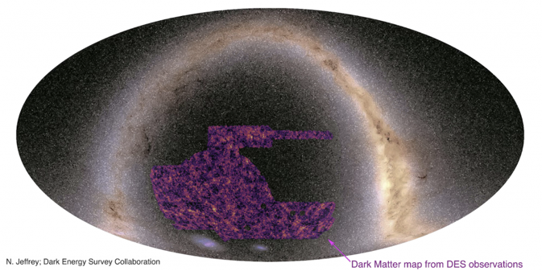
Gravitational Lensing and the Dark Energy Survey
Credit: EAGLE
Credit: Jeffrey et al. (2021)
Credit: ESA/Hubble & NASA

Slide 4



Spot the Gravitational Lens

