Slide 1

ASTRONOMY IN THE NEWS
#03 – FUTURE MISSIONS TO VENUS

Slide 2
Venus – Earth’s Twin?
Credit: NASA/JPL
Credit: NASA/Goddard Space Centre

Slide 3
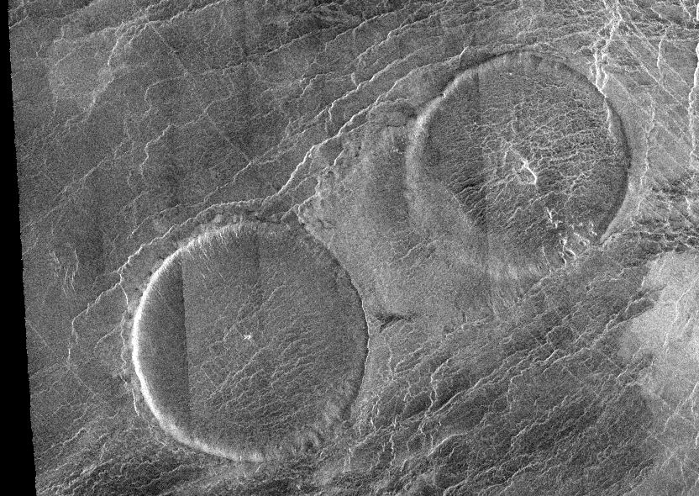
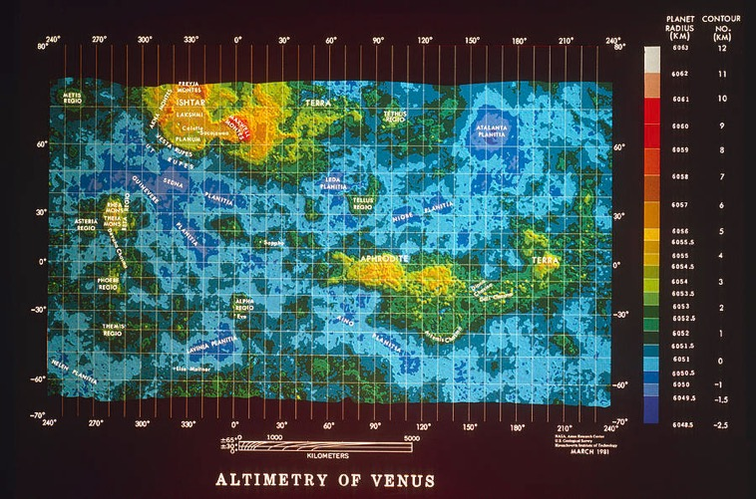
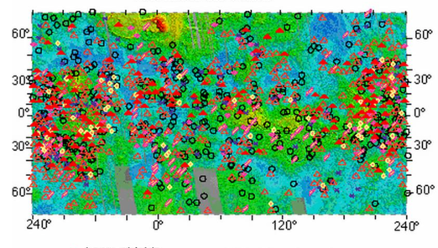
VERITAS and DAVINCI+
Credit: NASA/GSFC
Credit: NASA/JPL Caltech
Credit: NASA/GSFC
Credit: NASA/Ames/U.S. Geological Survey/MIT
Credit: Head et al. (1992)
Credit: Singh (2018)

Slide 4
Balancing Venus’ Chemical Reactions
S₂ + CO₂ SO₂ + CO
SO₂ + CO₂ SO₃ + CO
S₂ + CO₂ COS + SO₂ + CO

