Slide 1

ASTRONOMY IN THE NEWS
#05 – DIMMING OF BETELGEUSE

Slide 2
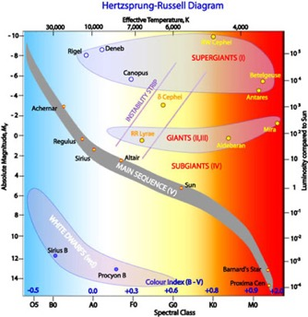

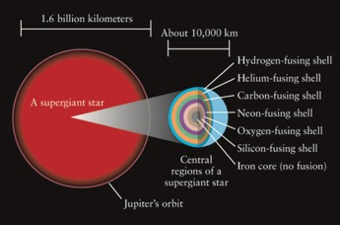
Red Supergiants
Credit: R. Hollow /CSIRO
Credit: NASA
Credit: University of Alberta

Slide 3
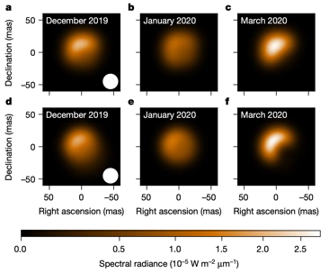
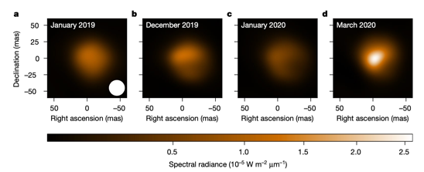
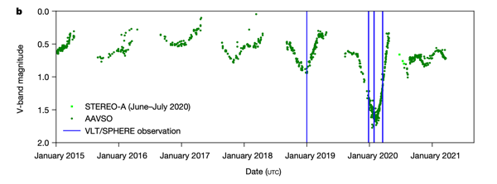
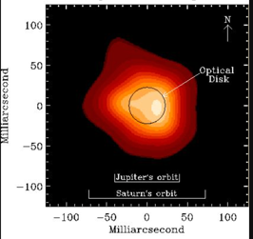
Dimming of Betelgeuse
Credit: Montarges et al. (2021)
Credit: Lim et al. (1998)

Slide 4

Periodicity of Betelgeuse
3/12/2016
2/11/2017
1/1/2019
28/1/2020
Credit: Montarges et al. (2021)
How does this compare to the 20 year period of 424±4 days?

