Slide 1

ASTRONOMY IN THE NEWS
#09 – HUBBLE SPACE TELESCOPE IS…REVIVED

Slide 2
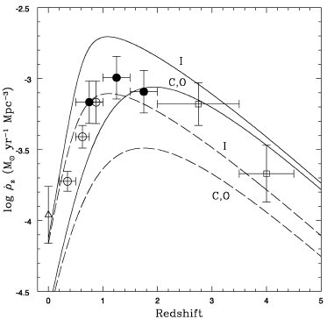
Hubble Deep Field
Credit: R. Williams (NASA/ESA/STScI)
Credit: Connolly et al. (1997)

Slide 3
Star formation revealed by proplyds
Credit: ALMA
Credit: R. O’Dell/Rice University/NASA

Slide 4
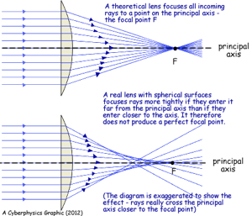
Activity
The mirror on the Hubble Space Telescope is flawed. The image here is an image of a star that should be a few pixels wide but is, instead, spread out over a large area.
This was caused by a spherical aberration on the mirror. How do you think this problem was solved? (knowing that it was impossible to replace the mirror)
Credit: NASA/COSTAR, ESA

