Slide 1

ASTRONOMY IN THE NEWS
#10 – HIGH-RESOLUTION GALAXY IMAGES

Slide 2
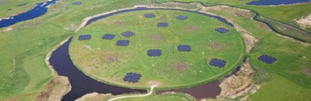
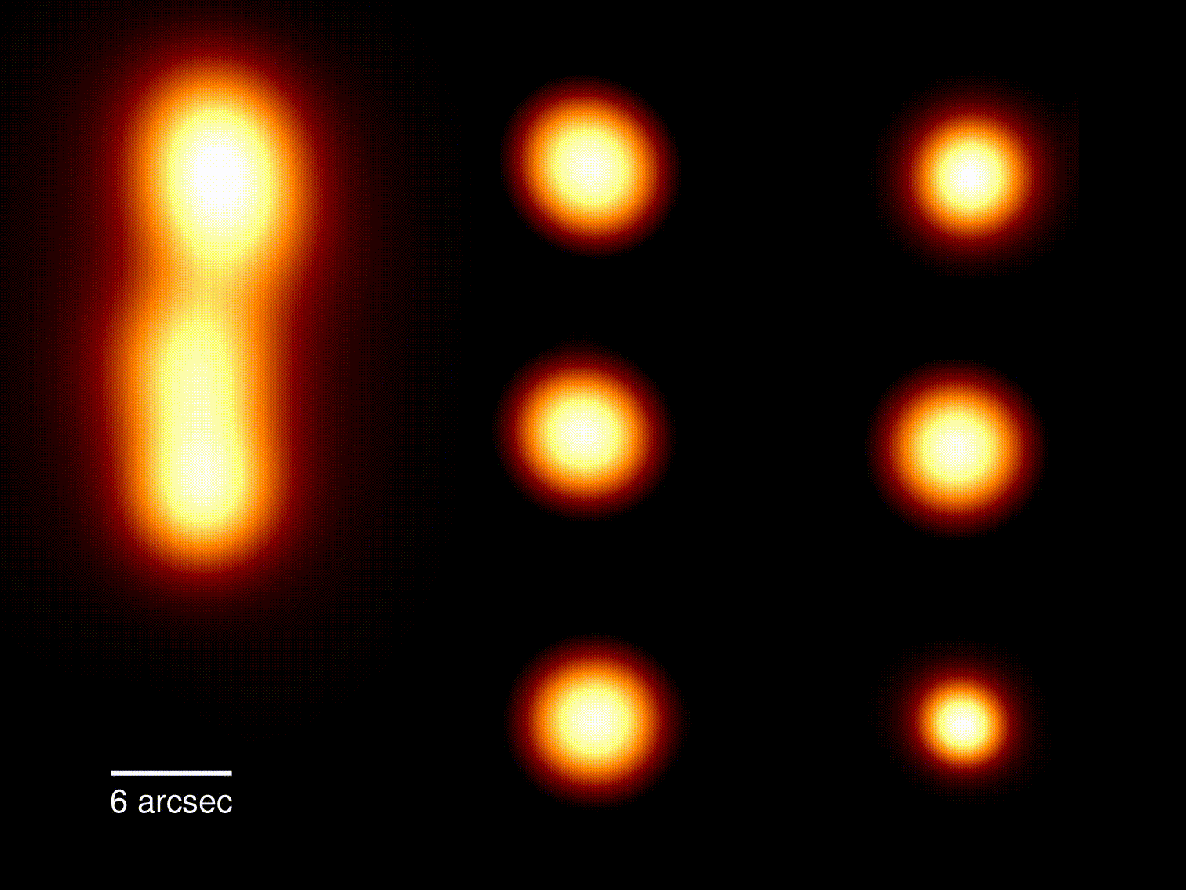
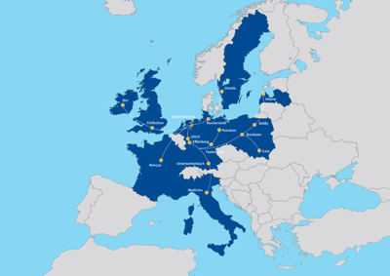
High-resolution Galaxy Images
Credit: LOFAR/ASTRON
Credit: Morabito et al. (2021)

Slide 3
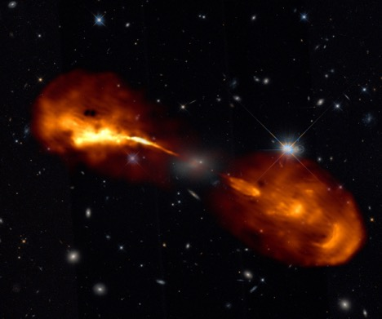
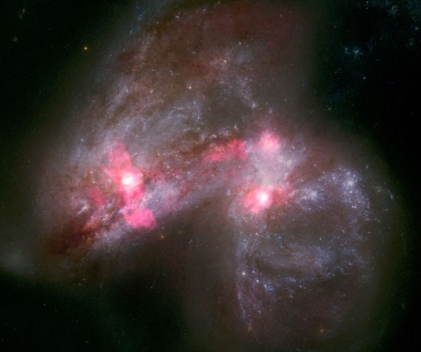
New structures revealed
Credit: Timmerman et al. (2021)
Credit: Ramirez-Olivencia et al. (2021)

Slide 4

How long are the outflows from Hercules A?
Size of lobe: 190 arcseconds, or 190/3600 degrees
Distance to Hercules A: 575 Mpc
Using trigonometry, how long is the lobe in kpc?
Credit: Timmerman et al. (2021)

