Slide 1

ASTRONOMY IN THE NEWS
#11 – Hycean Planets

Slide 2
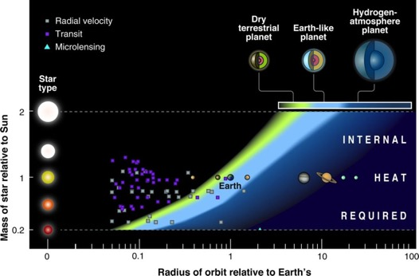
Planet Habitability
Credit: cmglee (Link)
Credit: Seager (2013)

Slide 3
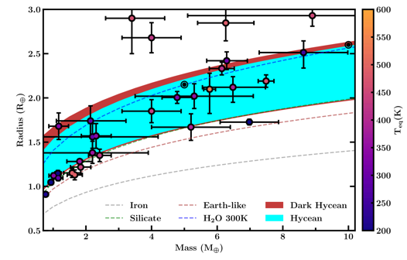
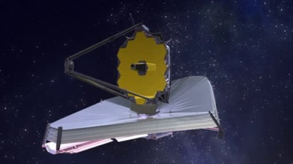
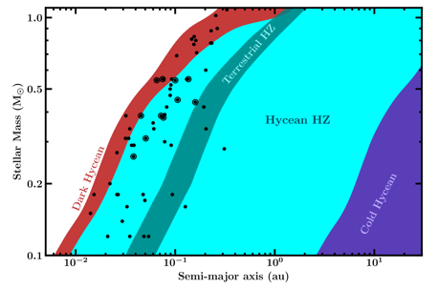
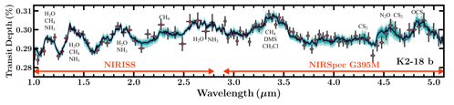
Hycean Planets
Credit: NASA/GSFC/Northrup Grumman
Credit: Madhusudhan et al. (2021)

Slide 4
Discussion Activity
These results are for a very idealised situation where only specific conditions on the planet are considered. However other chemical processes may impact how habitable a planet is, especially if it is primarily water.
There are other factors that can impact habitability and these are linked to the stellar activity. Certain stars are much more active than others and this activity includes high ultraviolet flux, coronal mass ejections and stellar winds that erodes planetary atmospheres. This can impact the ability to sustain life on those planets.
Can you think of any reasons why larger planets may be protected more than Earth-sized planets from this stellar activity?

