Slide 1

ASTRONOMY IN THE NEWS
#13 – LIGHT BEHIND A BLACK HOLE

Slide 2
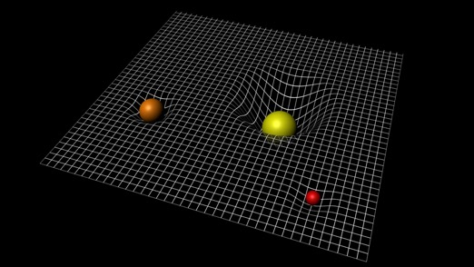
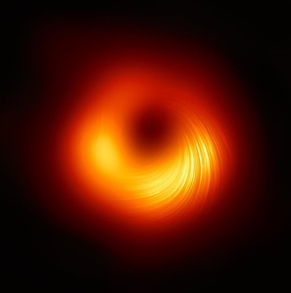
General Relativity and Black Holes
Credit: ESA
Credit: ESA/Hubble & NASA
Credit: Event Horizon Telescope

Slide 3
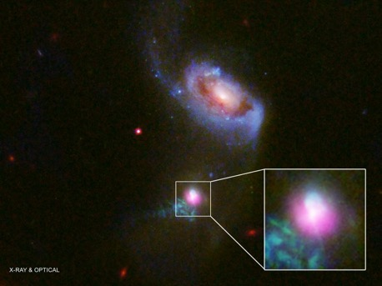
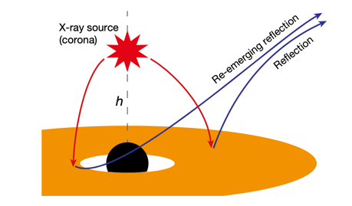
X-Rays around a black hole
Credit: HST/Chandra
Credit: Wilkins et al. (2021)

Slide 4
Simulating Gravitational Lensing
Credit: Ros (2008)
The effect of gravitational lensing can be demonstrated with a simple experiment. The only equipment required is a torch, a curved class and a dark liquid.
By shining the torch through the liquid, and moving around, you can observe repeated images of the light from the torch, and in some orientations, an arc of light with images in it.

