Slide 1

ASTRONOMY IN THE NEWS
#14 – THE INTERIOR OF MARS

Slide 2
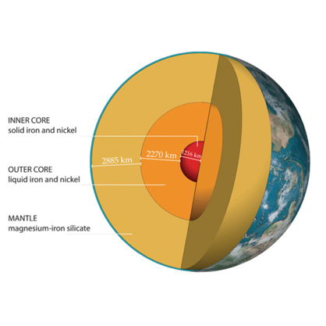
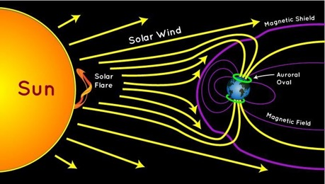
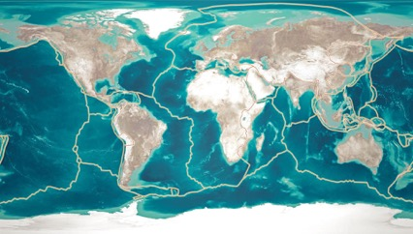
Structure of Earth
Credit: NASA
Credit: National Geographic
Credit: BGS/UKRI

Slide 3
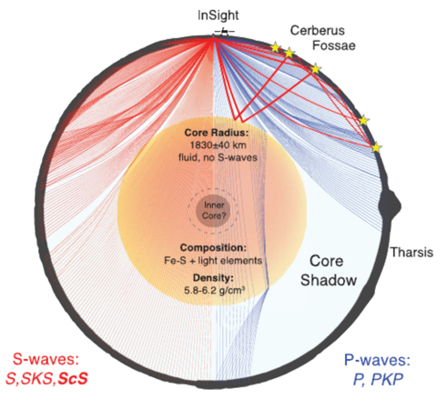
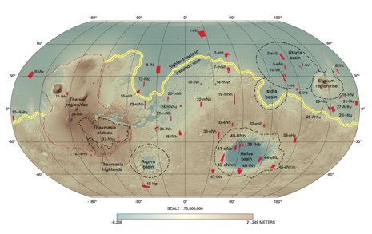
Interior of Mars
Credit: Mariaafrolen (Link)
Credit: Stahler et al. (2021)

Slide 4
How fast are reflected S waves?
S waves travel through the mantle are detected twice. However, using the time taken for waves to reflect from the core, can you measure the speed of the reflected S waves on Mars?
Marsquake | S wave time (seconds) | Reflected S wave (seconds)
1 | 167 | 511
2 | 168 | 510
3 | 172 | 513
4 | 173 | 512
5 | 177 | 510
6 | 230 | 500
Assumptions
The S wave travels half the distance that the reflected S waves travel
The reflected S waves travel the same distance after the reflection as they did before.
Planet Radius: 3390 km
Core Radius: 1830 km

