Slide 1

ASTRONOMY IN THE NEWS
#17 – MARS LIFE AND THE JEZERO CRATER

Slide 2
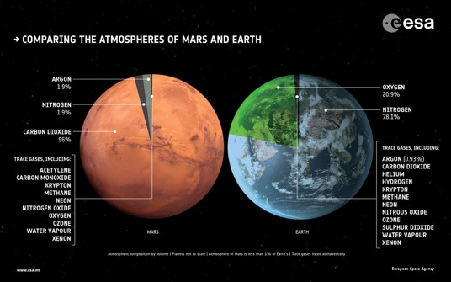
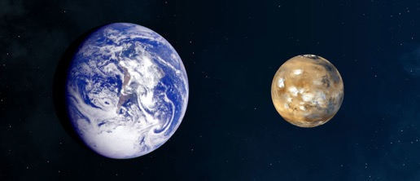
Mars vs. Earth
Credit: NASA
Credit: JPL/NASA

Slide 3
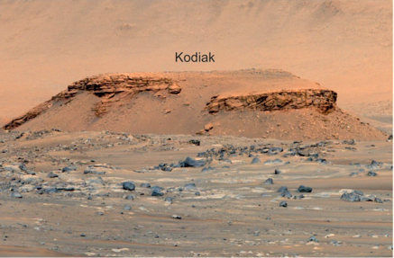
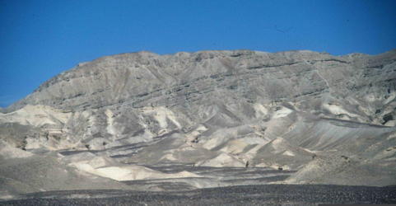
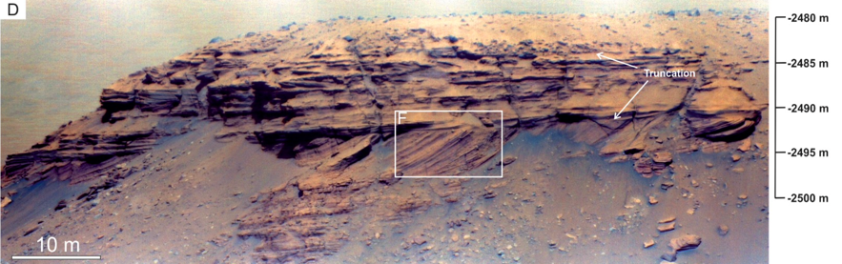
Jezero Crater
Credit: Sanjeev Gupta
Credit: Mangold et al. (2021)
Credit: Mangold et al. (2021)

Slide 4
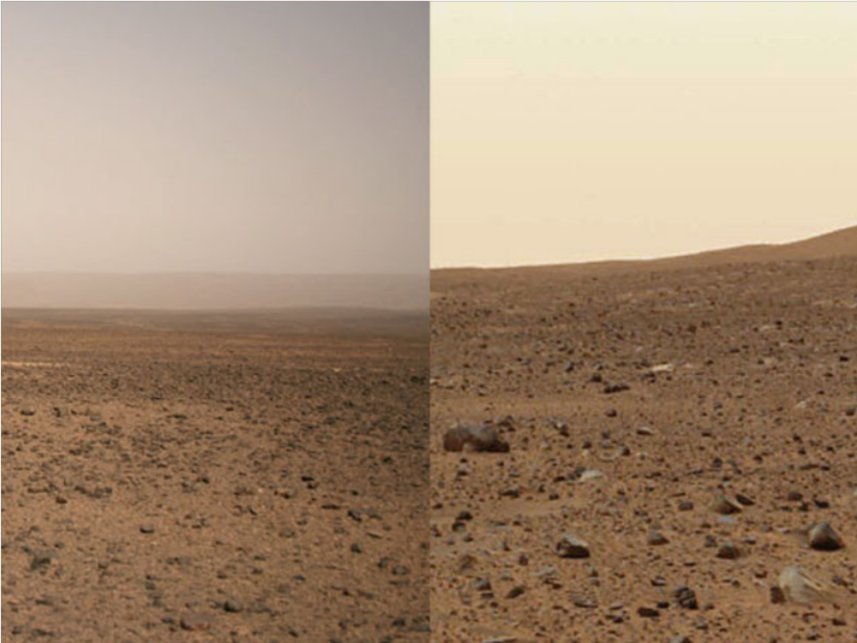
Mars or Earth?
Credit: JPL/NASA; Filipe Alves
These two photographs show very similar landscapes, but one is on Mars, one is on Earth, which is which?

