Slide 1

ASTRONOMY IN THE NEWS
#19 – THE SOLAR SYSTEM AFTER THE SUN DIES

Slide 2
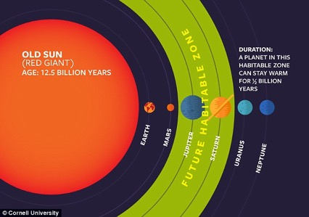

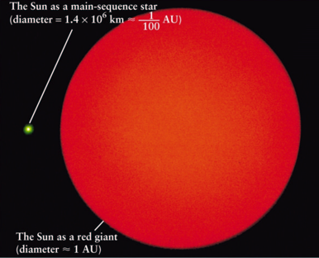
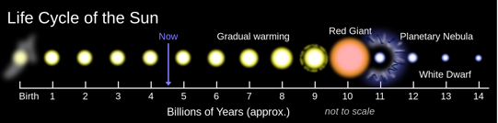
Evolution of the Sun
Credit: NASA
Credit: IfA Hawaii
Credit: Oliverbeatson(link)

Slide 3
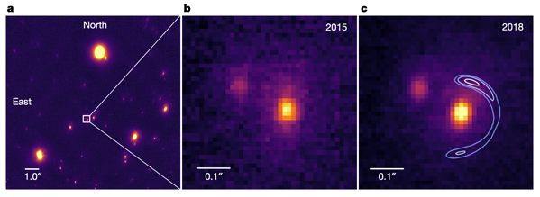
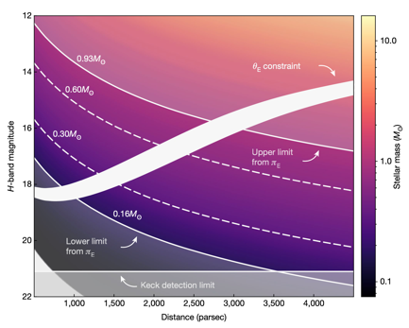
Planet orbiting a White Dwarf
Credit: All figures Blackman et al. (2021)

Slide 4
Relative distances of planets
The best way to visualise how different the size of the red giant Sun will be compared to the current Sun, is to make a model of the Solar System (or at least up to Jupiter).
Cut out 5 circles, representing the first 5 planets (they do not need to be to scale) and place them 38 cm, 72cm, 1m, 1.5m and 5.2m from the Sun.
Now imagine that the Sun is now ”1cm” across, the new outer most level of the Sun will be at the orbit of the Earth, if not further.

