Slide 1

ASTRONOMY IN THE NEWS
#21 – RADIO-DETECTED EXOPLANETS

Slide 2
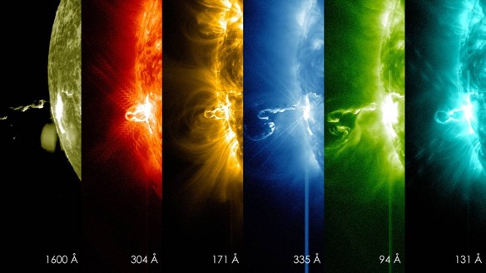
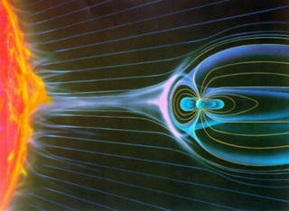
Stellar Flares
Credit: NASA
Credit: NASA/SDO

Slide 3
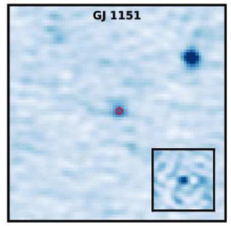
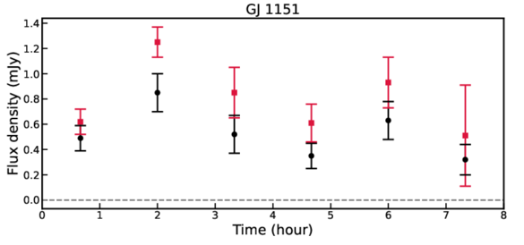
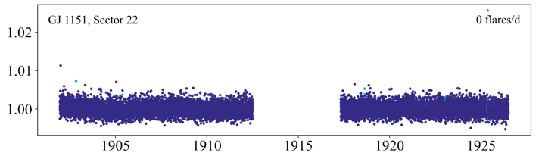
Radio-Detected Exoplanets
Credit: Callingham et al. (2021)
Credit: Pope et al. (2021)

Slide 4
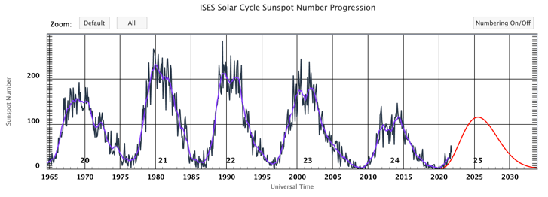
What is the Solar cycle?
Credit: NOAA
Using the data above, can you estimate the length of a solar cycle? The solar cycle is defined as the length of time between either the peaks or dips in the graph above. This shows the number of sunspots, i.e. more spots, more stellar activity.

