Slide 1

ASTRONOMY IN THE NEWS
#24 – DART MISSION LAUNCHES

Slide 2
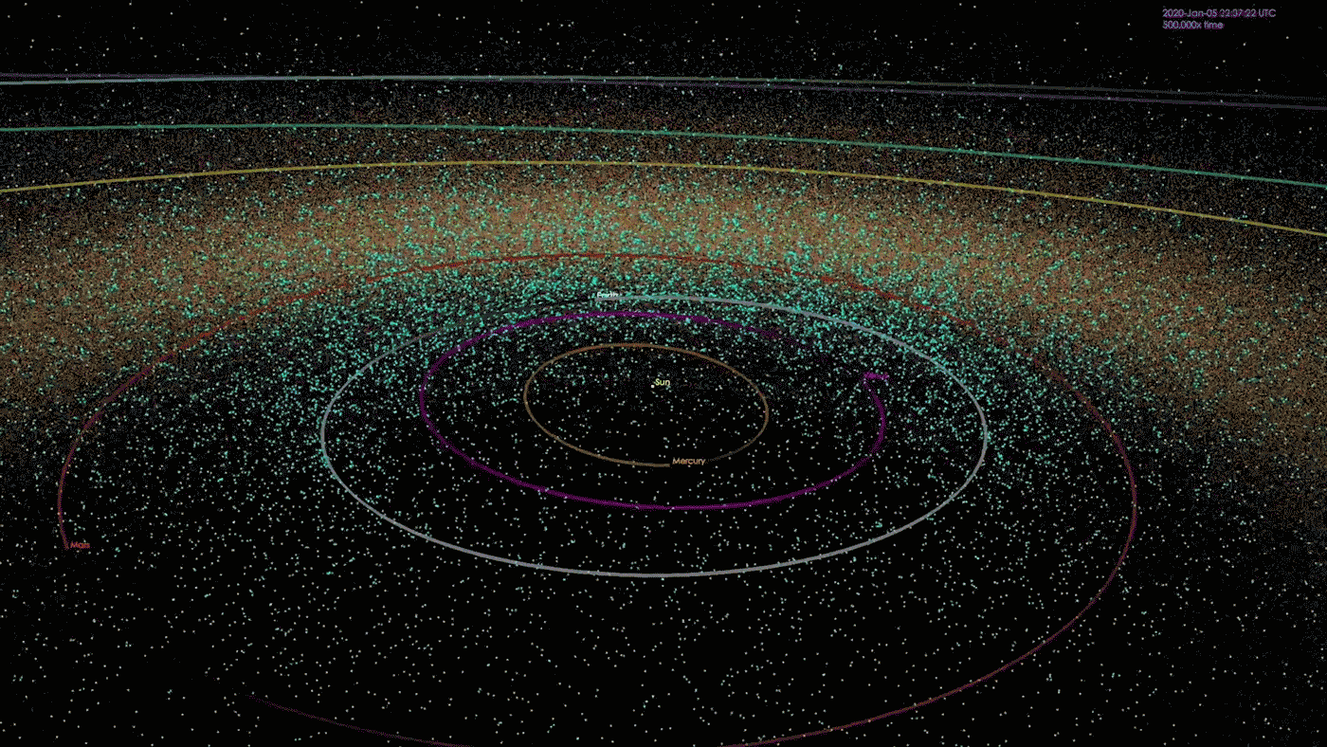
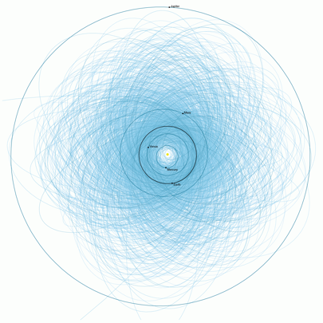
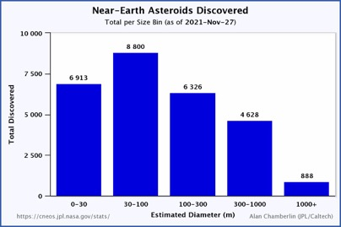
Planetary Defence
Credit: NASA/JPL/Caltech
Credit: NASA/JPL/Caltech

Slide 3
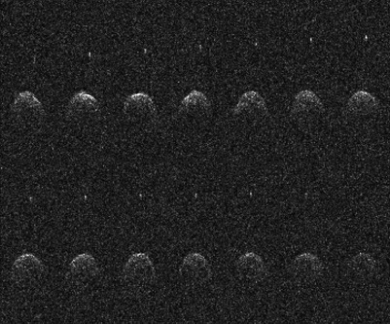
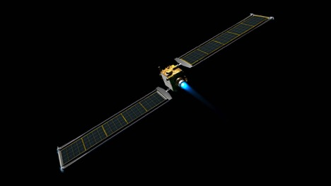
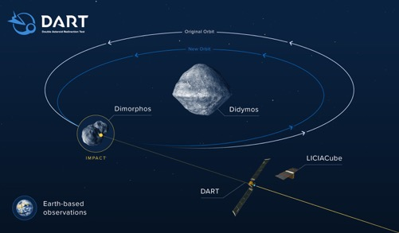
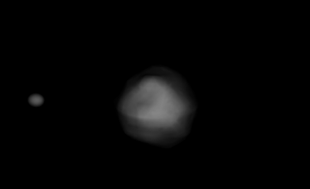
The DART Mission
Credit: Arecibo/NSF
Credit: NASA/JPL
Credit: NASA/JPL
Credit: Naidu et al. (2016)

Slide 4

How much is the orbit changed?
Kepler’s third law describes how the time of orbit is linked to its distance from the central mass.
This takes the form of:
$$T^{2}= \frac{4π}{GM}a^{3}$$
Where T is the orbital time, G is the gravitational constant, M is the mass of the central object and a is the distance from the centre.
Taking the initial orbital time as 11.92 hours, the new orbital time as 10 minutes less (11.75 hours) and the starting orbit as 1 km, what is the new orbital distance?

