Slide 1

ASTRONOMY IN THE NEWS
#25 – RECORD GRAVITATIONAL WAVE DETECTIONS

Slide 2
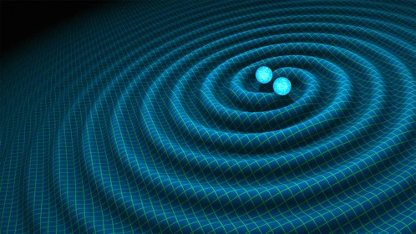
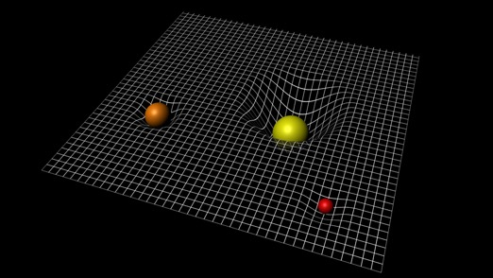
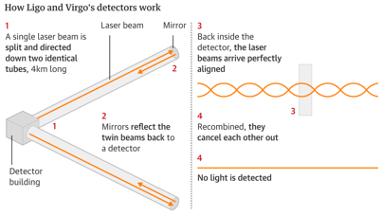
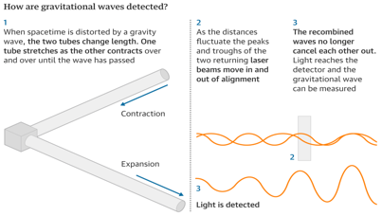
Gravitational Waves
Credit: R Hurt/Caltech/JPL
Credit: ESA
Credit: Guardian/LIGO/Scientific American

Slide 3
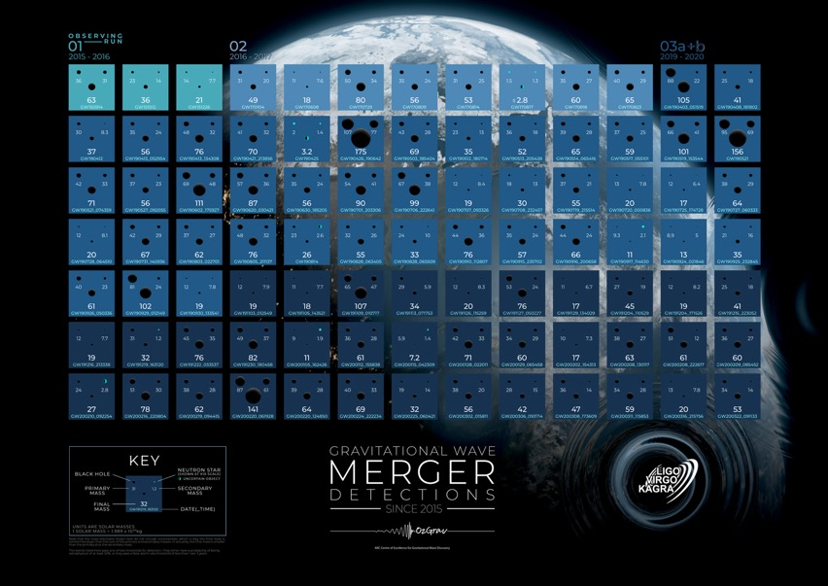
GW Sources

Slide 4
How “significant” are detections?
A gravitational wave produces a strain of 1 part per 10⁻²⁰. How much change would this level of detection produce in 4km-long arm of LIGO? Which physical objects does this size scale most closely resemble?

