Slide 1

ASTRONOMY IN THE NEWS
#27 – HOW STARS BECOME BLACK HOLES

Slide 2

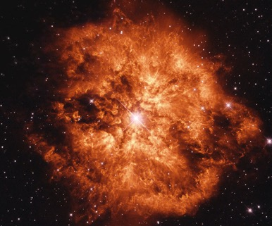
Core-Collapse Supernova
Credit: NASA
Credit: HST/NASA/ESA

Slide 3
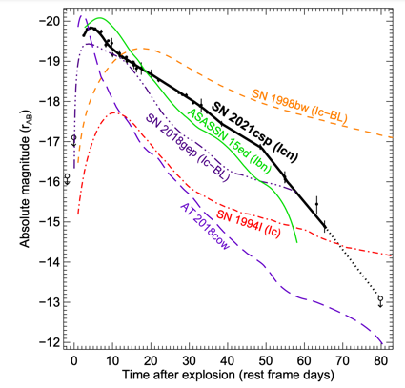
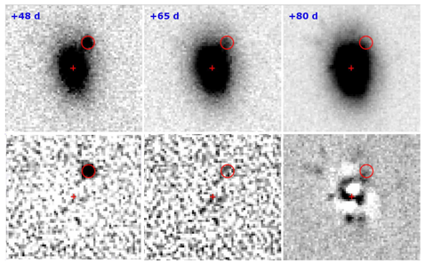
From a star to a black hole
Credit: Perley et al. (2022)

Slide 4

How fast is the stellar wind of a Wolf-Rayet star?
The nebula of this Wolf-Rayet star is 6 light years across. The central star has expelled gas for 20,000 years. How fast are the stellar winds of this star to create a nebula of this size over that time?
IMPORTANT INFORMATION
1 lightyear = 9.461 x10¹⁵ m
1 year = 3.154 x10⁷ s
Credit: HST/NASA/ESA

