Slide 1

ASTRONOMY IN THE NEWS
#28 – GIANT ATOMIC FILAMENTS

Slide 2
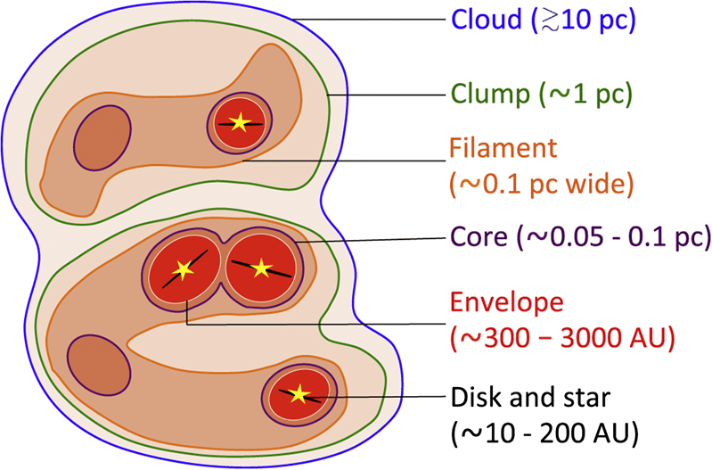
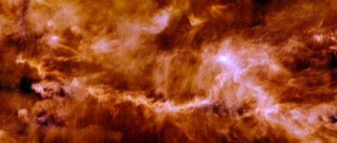
Filaments and Star Formation
Credit: Herschel Space Observatory
Credit: Pokhrel et al. (2018)
Credit: NASA/GSFC

Slide 3
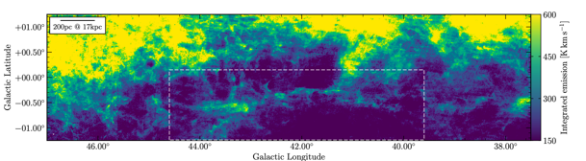
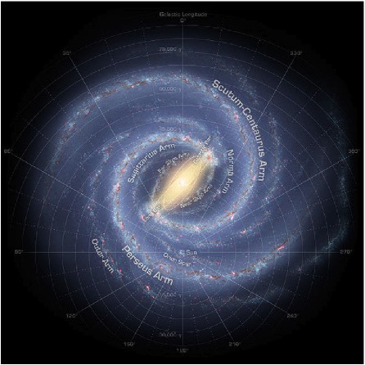
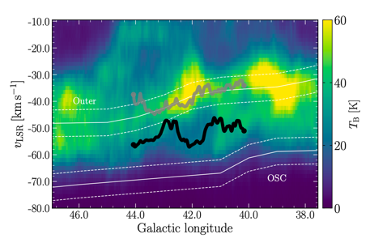
Giant Atomic Filament
Credit: NASA/JPL Caltech/R Hunt
Credit: Syed et al. (2022)

Slide 4
How do stars form?
There are 6 main stages to the process of star formation. Can you put these stages into the correct order?
Process | Correct Order | Process | Correct Order
Regions within the cloud become denser and denser and gravity starts to cause these regions to collapse. |  | Regions get denser and become hotter. The cloud starts to spin and produce a disc, with an outflow.
A molecular cloud has no current star formation. |  | The forming star blows away the remaining cloud material, leaving the star isolated.
Star becomes hotter and begins to burn hydrogen via nuclear fusion. |  | A star remains and burns for lengths of time of 500,000 years to billions of years.

