Slide 1

ASTRONOMY IN THE NEWS
#29 – HABITABLE PLANET AROUND A WHITE DWARF

Slide 2
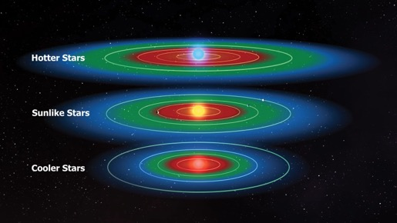

The Goldilocks Zone
Credit: NASA
Credit: Kepler/Ames Research Center/NASA

Slide 3
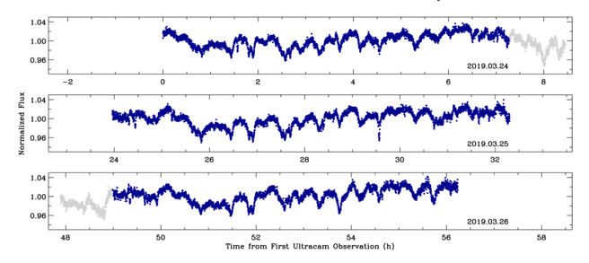
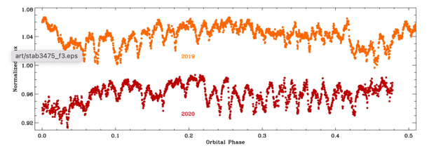
Habitable Planet around a White Dwarf?
Credit: Farihi et al. (2022)
Credit: NASA Ames

Slide 4
How far away from the star is the planet?
The orbital period of the potential planet is 25.02 hours, and the speed of the planet is 180 km/s. Using this information, what is the orbital radius of the planet in units of solar radii? (Assuming a circular orbit)
Solar Radii: 6.957 x10⁵ km

