Slide 1

ASTRONOMY IN THE NEWS
#30 – NOT A BLACK HOLE…JUST A BINARY

Slide 2
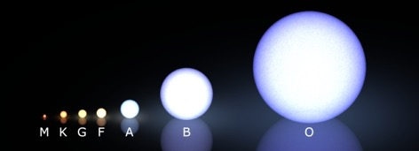

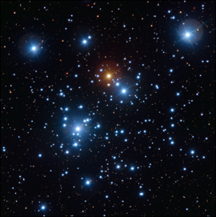
Binary Stars and Massive Stars
Credit: Rursus
Credit: ESO/VLT
Credit: R Hollow/CSIRO

Slide 3
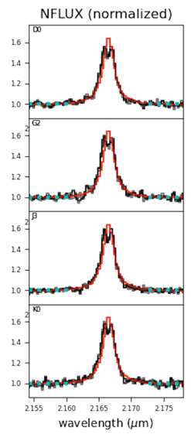
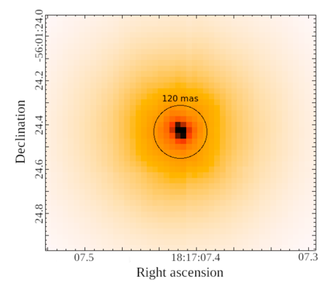
HR 6819: Black Hole or Binary
Credit: Frost et al. (2022)

Slide 4

Understanding Resolution
The resolution of a telescope depends on the collecting area of the telescope and the wavelength you are trying to look at.
The formula for calculating this:
$θ=1.22\frac{λ}{D}$
Where 𝜽 is the angular resolution (in radians), λ is wavelength in metres and D is the collecting area of the telescope in metres.
What is the angular resolution of your eye (use 4mm as the diameter)? What is the angular resolution of the VLT, which observed the system, with a collecting area of 7m? Assume 550nm as the wavelength of visible light.
Arcseconds (1/3600 of a degree) to radians
1 arcsecond = 4.84 x10⁻⁶ radians
How do these compare?

