Slide 1

ASTRONOMY IN THE NEWS
#31 – A NEW PLANET AROUND THE CLOSEST STAR

Slide 2
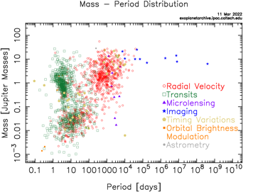
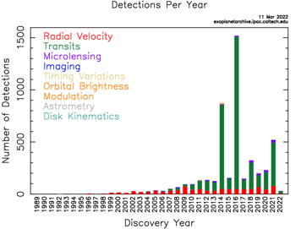
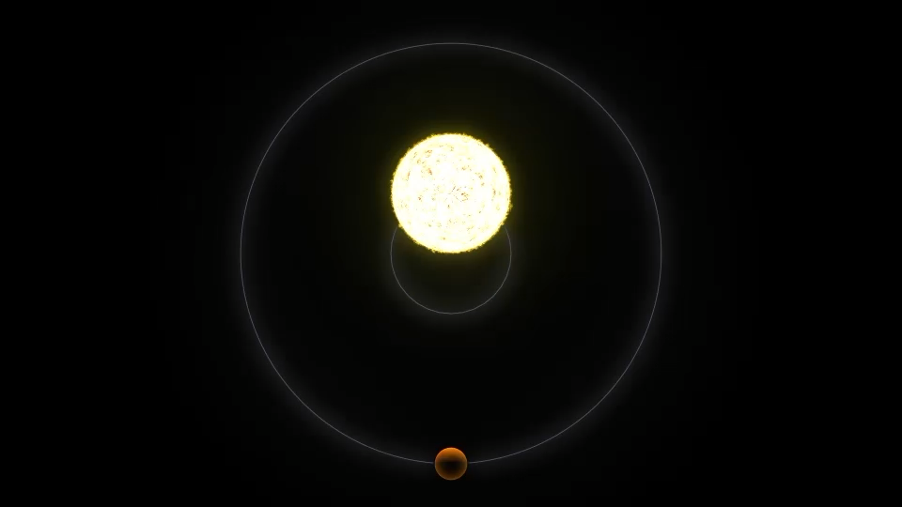
Radial Velocities for Detecting Exoplanets
Credit: NASA

Slide 3
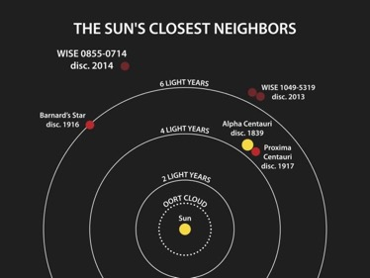
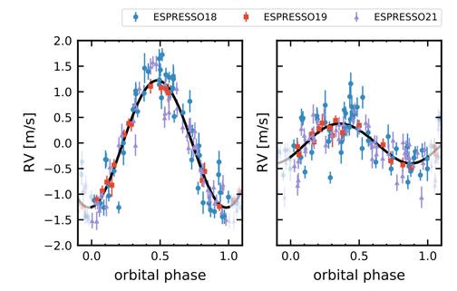
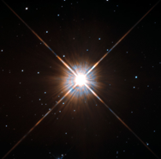
Proxima Centauri and its Planets
Credit: NASA/Penn State University
Credit: Faria et al. (2022)
Credit: HST/ESA

Slide 4
Calculating the mass of an exoplanet from radial velocities
The mass of an exoplanet can be calculated once you have information about the radius of the orbit and the mass of the star. Can you calculate the radial velocity variation and the mass of the exoplanet in the following example?
https://www.rmg.co.uk/schools-communities/teacher-resources/mass-exoplanet-radial-velocity

