Slide 1

ASTRONOMY IN THE NEWS
#33 – NATURE OF BLACK HOLES

Slide 2
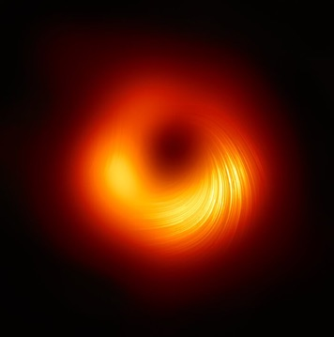
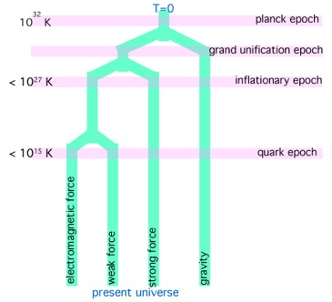

Black Holes and the Fundamental Interactions
Credit: Event Horizon Telescope
Credit: NASA
Credit: University of Texas

Slide 3
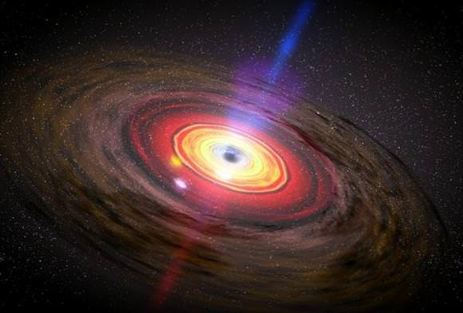
Hairy Black Holes?
Credit: NASA/Dana Berry/ SkyWorks Digital

Slide 4
Is an untestable theory science?
The direct detection of gravitons is considered impossible. However, their existence is postulated through the theory of quantum gravity, along with theories like the quantum hair discussed here.
Other theories, such as string theory are not currently testable with the technology available today.
The question to be asked then is, are scientific theories that cannot be proven experimentally science or simply just philosophy?

