Slide 1

ASTRONOMY IN THE NEWS
#34 – MOST DISTANT STAR EVER DISCOVERED

Slide 2
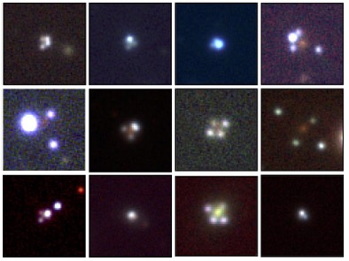
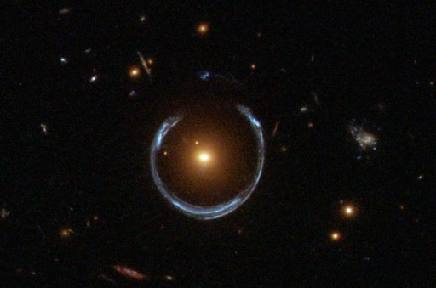
Gravitational Lensing
Credit: HST/NASA/ESA
Credit: GraL collaboration/ESA

Slide 3
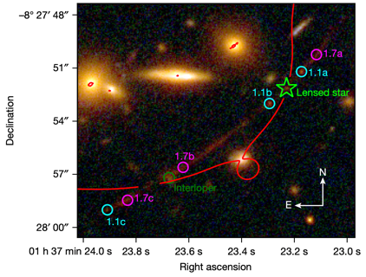
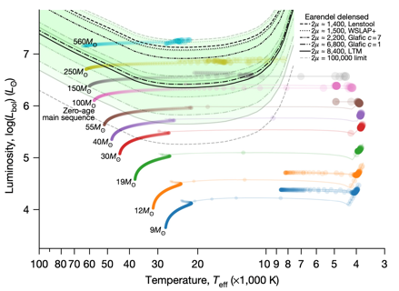
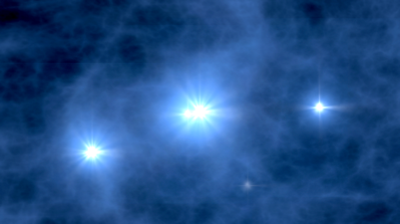
Most Distant Star
Credit: Welch et al. (2022)
Credit: Welch et al. (2022)
Credit: NASA/WMAP

Slide 4
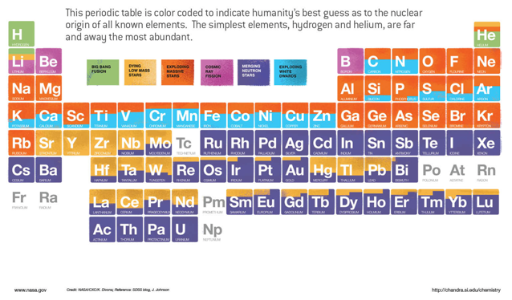
How do heavier elements form?
This periodic table shows how we believe each element was created in the Universe. The orange sources are those that form in massive stars, via supernovae. However, iron is the heaviest element created in the cores of those massive stars before it explodes, why is this? How does a supernova create more elements?

