Slide 1

ASTRONOMY IN THE NEWS
#36 – JWST IS FULLY ALIGNED

Slide 2
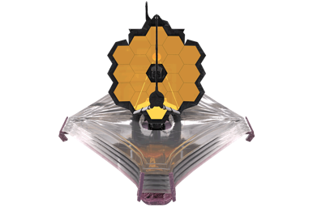
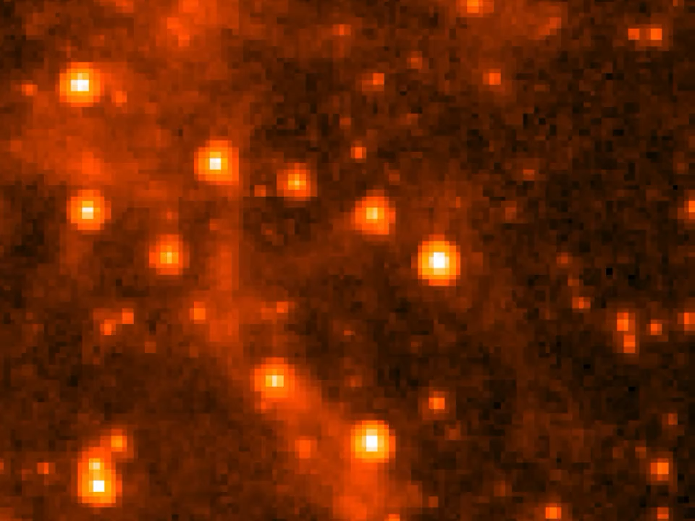
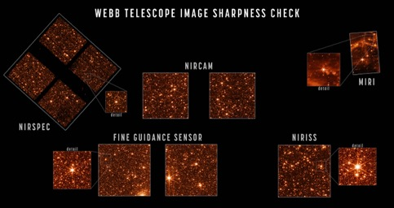
JWST is Aligned
Credit: JWST/NASA/GSFC
Credit: Karin Sandstrom
Credit: JWST/NASA/ESA/CSA

Slide 3
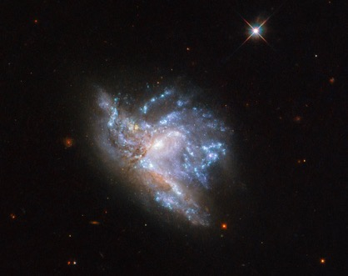
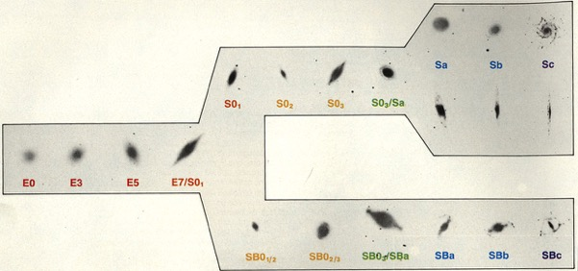
Galaxies Over Time
Credit: NASA/HST/ESA
Credit: University of Washington

Slide 4

How far away is the LMC?
Credit: Karin Sandstrom
The resolution of the JWST image here is 0.07 parsecs at a wavelength of 7.7 μm. Using the Rayleigh criterion, and the primary mirror size of 6.5 m and trigonometry, can you calculate the distance, in parsecs, to the Large Magellanic Cloud?
$$θ=\frac{1.22λ}{D}$$
where 𝜽 is the angular resolution in radians (either needs converting or your calculator switching to radians), λ is the observed wavelength and D is the diameter of the primary mirror.

