Slide 1

ASTRONOMY IN THE NEWS
#37 – PRIORITISE URANUS FOR A NEW SPACE MISSION

Slide 2
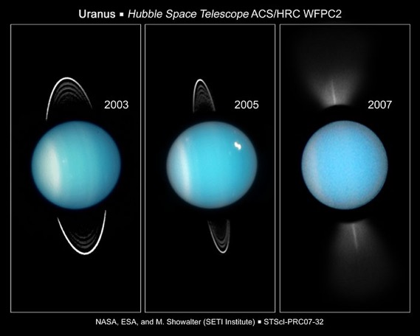
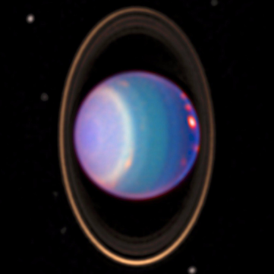
Uranus
Credit: NASA/HST

Slide 3
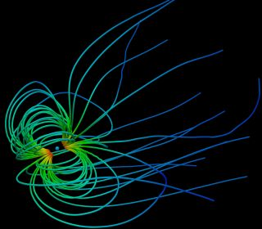
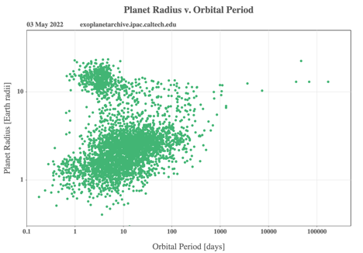
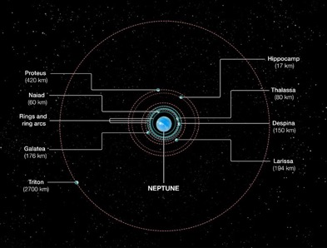
A mission to Uranus
Credit: Lars Mejnertsen/Imperial College
Credit: NASA/ESA/A Field (STScI)

Slide 4
Investigating Uranus-like planets
Using the following website:
https://exoplanetarchive.ipac.caltech.edu/cgi-bin/IcePlotter/nph-icePlotInit?mode=demo&set=confirmed
Investigate the properties of exoplanets, and in particular, those that are like Uranus.
Plots to investigate would be: radius vs. mass, orbital distance/period vs. mass/radius, and histograms such as radius and mass.
What do you find? Are there many “hot Uranus” planets? What is the mode of the discoveries in terms of radius and mass.
Important Information:
Uranus mass = 0.05 Jupiter mass
Uranus radius = 0.36 Jupiter radius

