Slide 1

ASTRONOMY IN THE NEWS
#44 – ANCIENT LIFE ON MARS

Slide 2
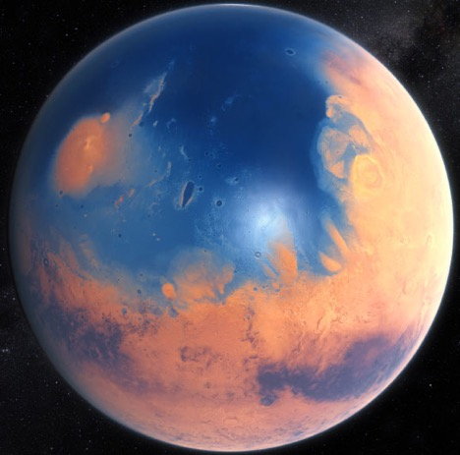
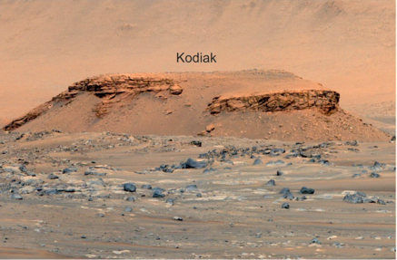
Background Science
Credit: Mangold et al. (2021)
Credit: M Kornmesser/ESO

Slide 3
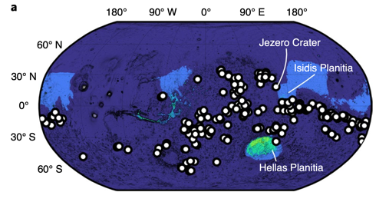
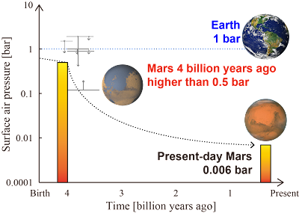
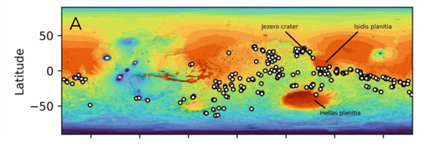
Early Martian Life
Credit: Hiro Kurokawa (Tokyo Institute of Technology)
Credit: Sauterey et al. (2022)

Slide 4
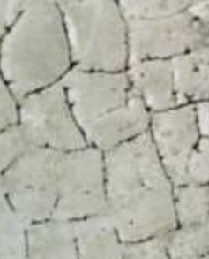
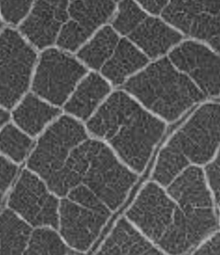
Was there water on Mars?
When a lake dries out on Earth, large cracks appear, causing polygon shapes. These same features are seen on Mars. Which is Earth, which is Mars? Do you think this is evidence for ancient water formations on Mars?
Credit: Google, NASA/JPL

