Slide 1

ASTRONOMY IN THE NEWS
#52 – LARGEST COSMIC EXPLOSION

Slide 2

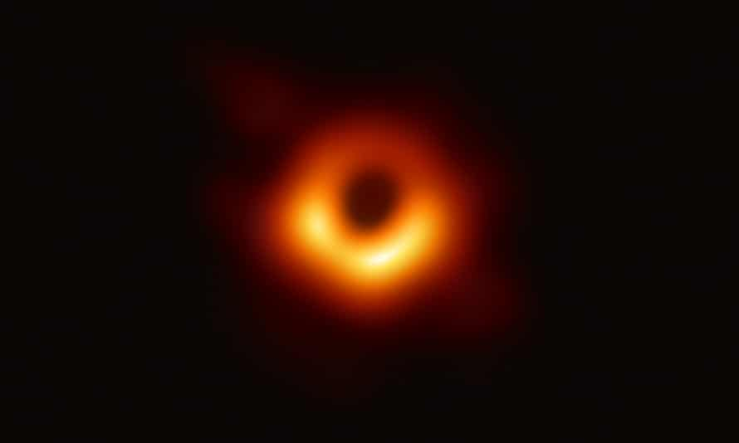
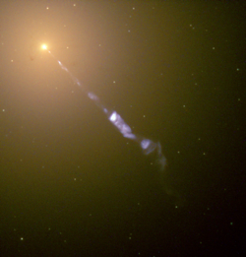
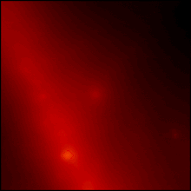
Central Black Holes and Cosmic Explosions
Credit: EHT
Credit: M Weiss
Credit: HST/NASA/STScI
Credit: NASA/Fermi LAT Collaboration

Slide 3

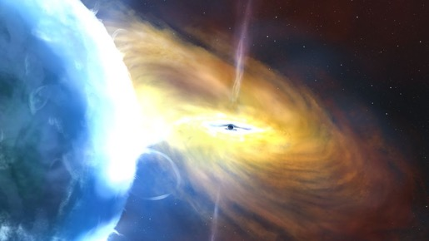
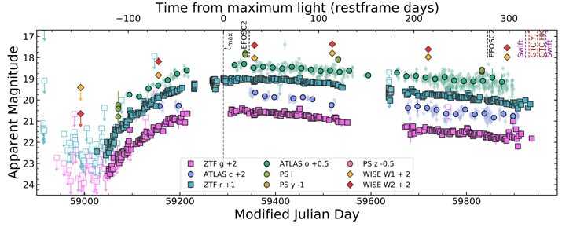
Largest Cosmic Explosion
Credit: John A Paice
Credit: NASA
Credit: Wiseman et al. (2023)

Slide 4
How much brighter is AT2021lwx than the Sun?
The brightness of objects in the sky is measured in a quantity called magnitudes. There are two types, apparent and absolute. Apparent magnitude is how bright something appears to us on Earth, whereas absolute magnitude is how bright everything would be if they were at a constant distance. This is a measure of true brightness.
The peak apparent magnitude of AT2021lwx is 18, but the absolute magnitude is -22.25. The Sun has values of -26.74 and 5.17, respectively. The SMALLER the number, the brighter it is.
Each magnitude is 2.5 times brighter, therefore a difference of 5 magnitudes is about 100 times in brightness.
How much brighter is AT201lwx than the Sun with a difference of 27.42 magnitudes in absolute magnitude?

