Slide 1
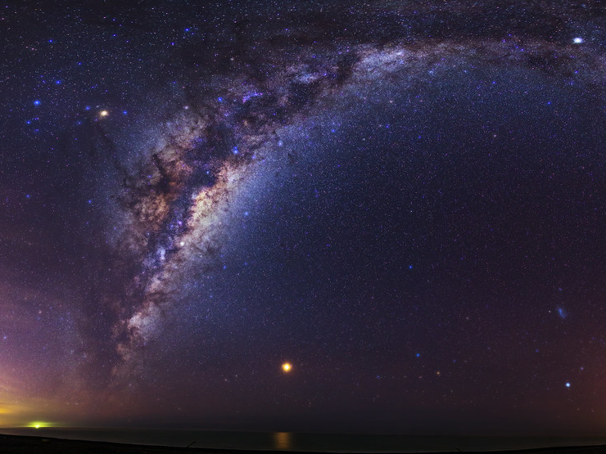
ASTRONOMY IN THE NEWS
#57 – OVERWEIGHT PLANET

Slide 2
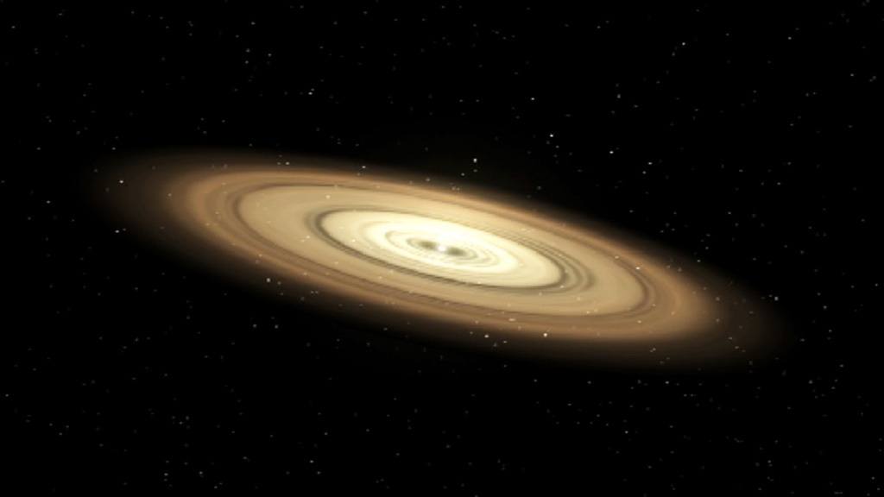
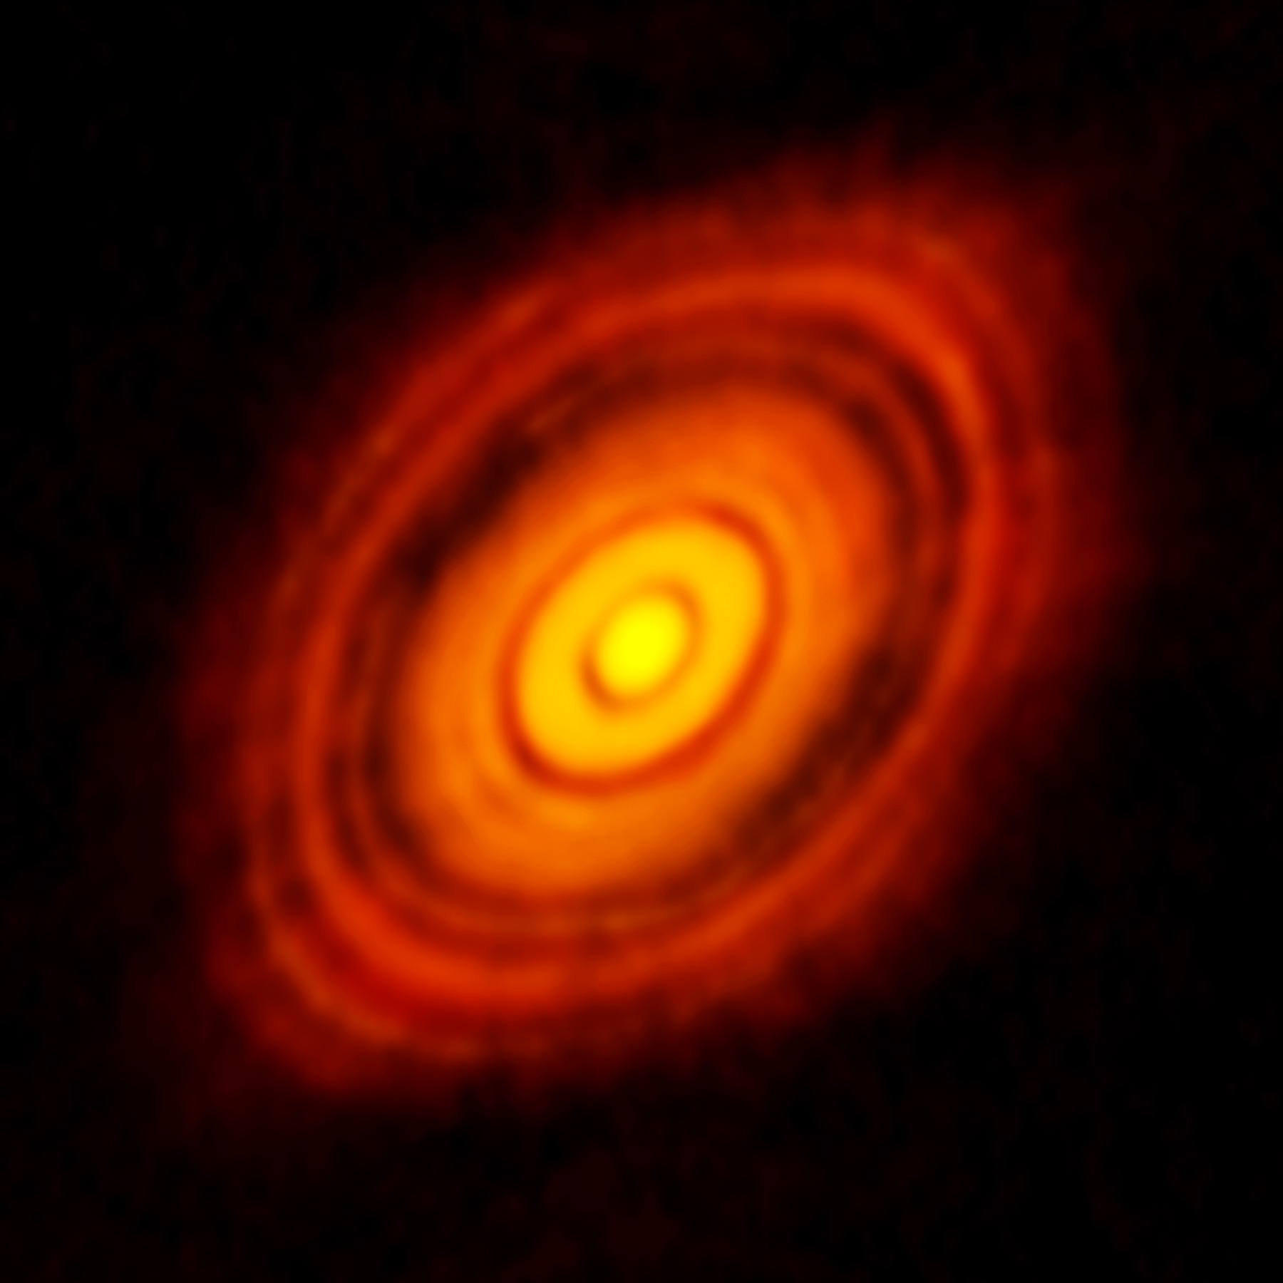
Planet Formation
Credit: NASA
Credit: ALMA/ESO/NAOJ/NRAO

Slide 3
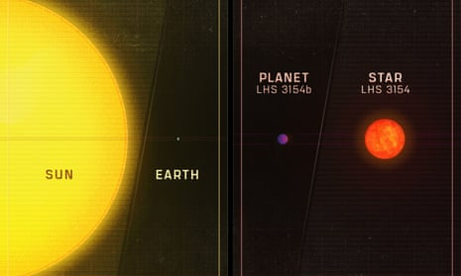
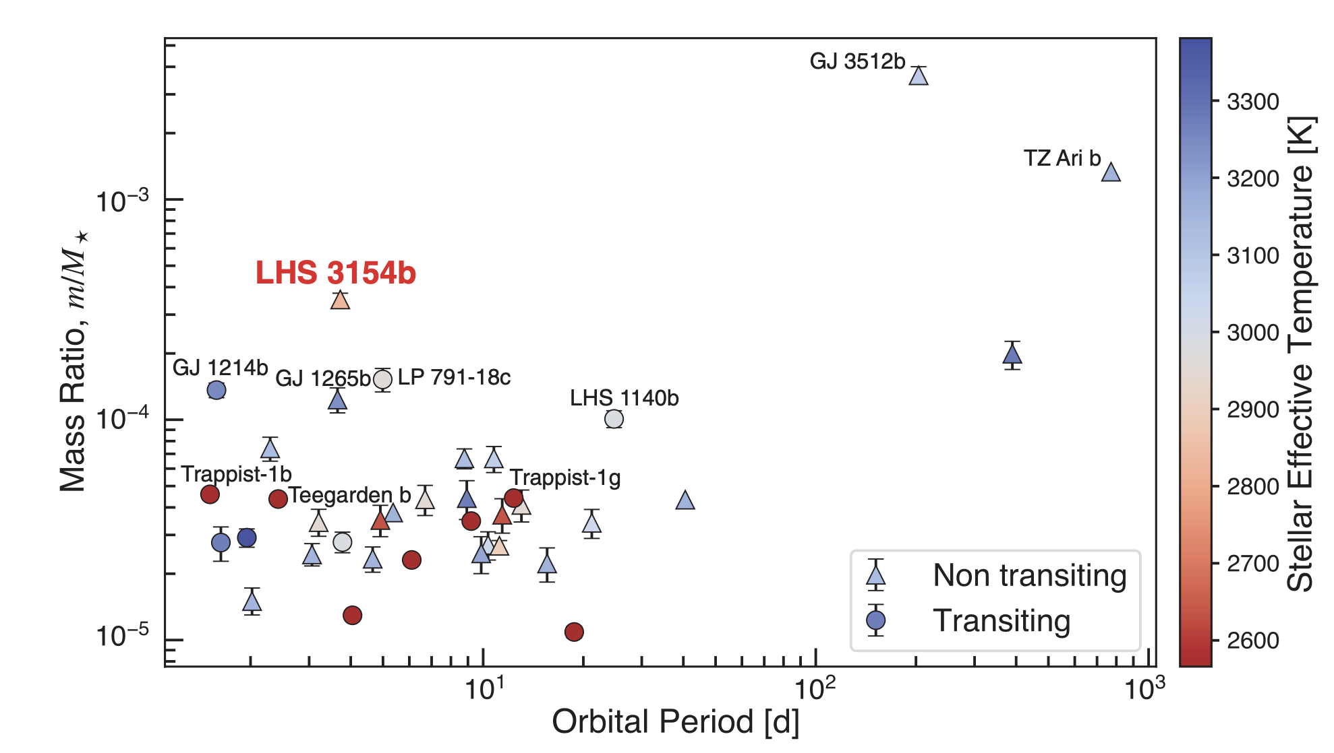
Overweight Planet
Credit: Stefansson et al. (2023)
Credit: Penn State University

Slide 4


Confirm the orbital radius
Given the orbital time and the mass of the star, can you calculate the orbital radius of LHS 3154b? These three quantities are related through Kepler’s Third Law which is given by the following formula:
$T^{2}=\frac{4π^{2}}{GM}R^{3}$
In this formula, if the time (T) is in units of years, stellar mass (M) is in units of solar masses, and orbital radius (R) is in units of astronomical units, then ${4π^{2}}/G$ = 1.
T: 3.7 days
M: 0.11 M⦿

